Slide 1
Mapping the Spread of Religions Using Wikipedia
Jason Krone and Ian Leaman

Slide 2
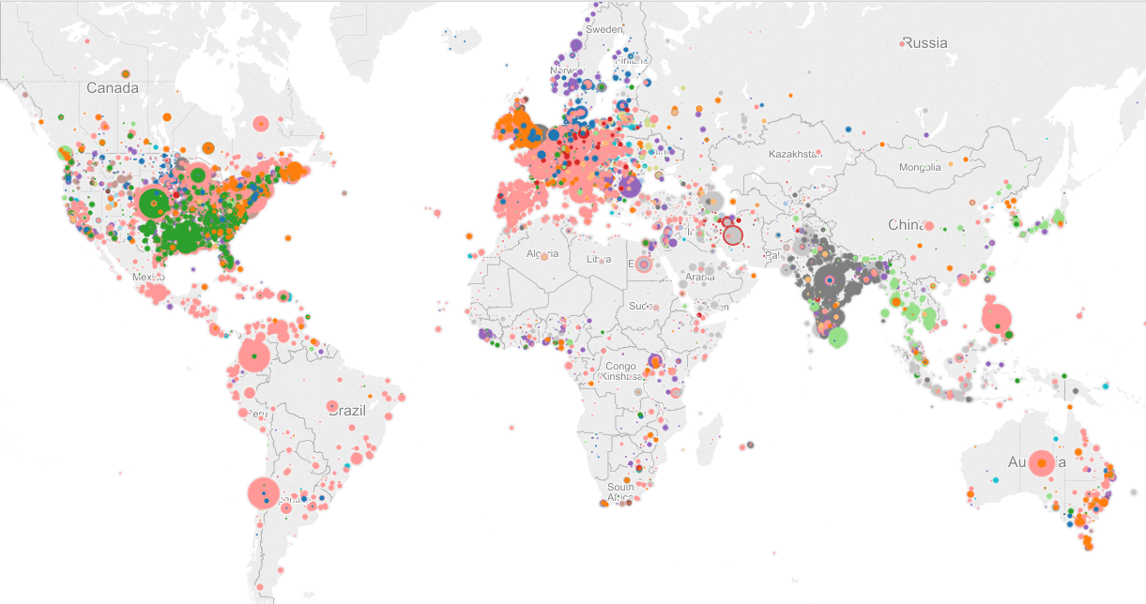
Purpose: map the spread of different religions over time in order to observe religious development and movement.

Slide 3
Methodology
Process Wikipedia info boxes
Extract people from info boxes
Connect people to locations through one of two methods
  Geopy
  Location table generated from wiki data
Store people and locations in SQL database
Build authority list* for each religion by analyzing SQL data with a script
Group people from database using new authority lists for graphing.
Graph using Tableau

Slide 4
Top Ten Wikipedia Religions
roman catholic: 4156
roman catholicism: 2331
islam: 1973
catholic church: 1654
christian: 1227
&lt;!-- religion should be supported with a citation from a reliable source --&gt;: 1062
presbyterian: 956
baptist: 900
catholic: 841
methodist: 802

Slide 5
Wikipedia Bias
Predominately focused on Christian religions
May have a very western focus
Relying on people famous enough to be on Wikipedia
Wiki dump provided in class was primarily English language

Slide 6
Statistics
We scanned 2,628,531 total boxes from Wikipedia
  Wikipedia data contains about 286,000 usable* locations
  And contains 28,700 valid people*
There was a 2.4% error rate when matching people to locations using geopy
Meta Category Statistics:
  Our categories cover 71% of all religions in Wikipedia.
  Despite a significant amount of unusable “religions” (IE: forbes)

Slide 7
Meta Categories*
Islam: islam, muslim, shi'a, shia, sunni, alawite
Christianity: christian, catholic, baptist, calvini, protestant, episcopal, lutheran, congregationalist, jehovah's witness, unitarian, presbyterian, anglican
Judaism: judaism, jew, hasidic, haredi
Budhism: buddhi*
Hinduism: hindu
Mormonism: lds, flds, church of jesus christ of latter day saints
None: none, atheism, agnostic

Slide 8
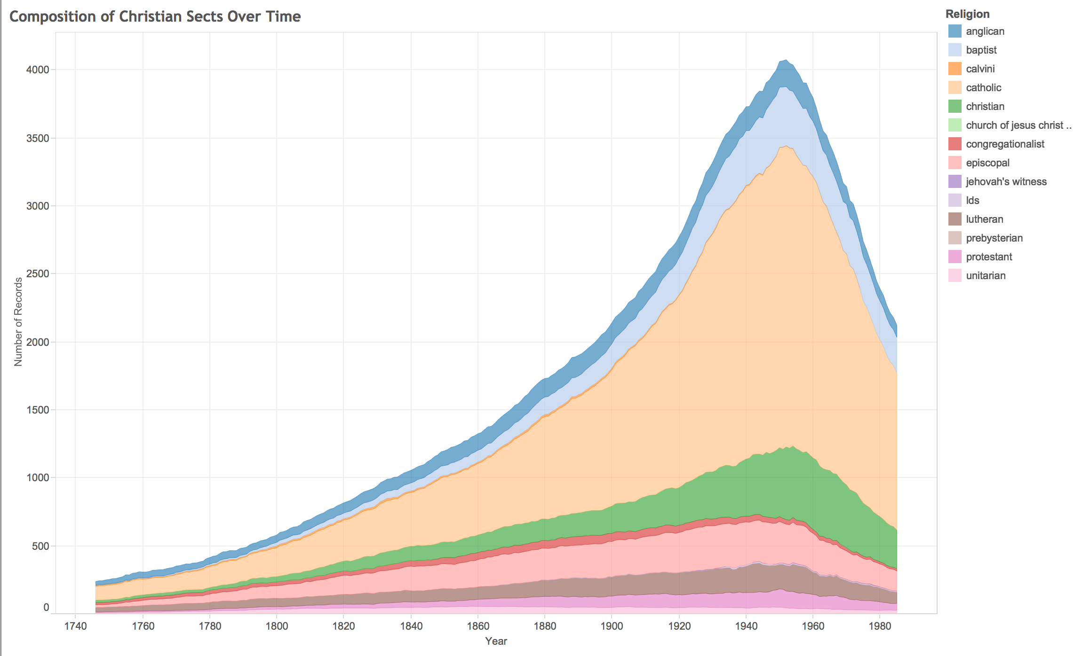

Slide 9
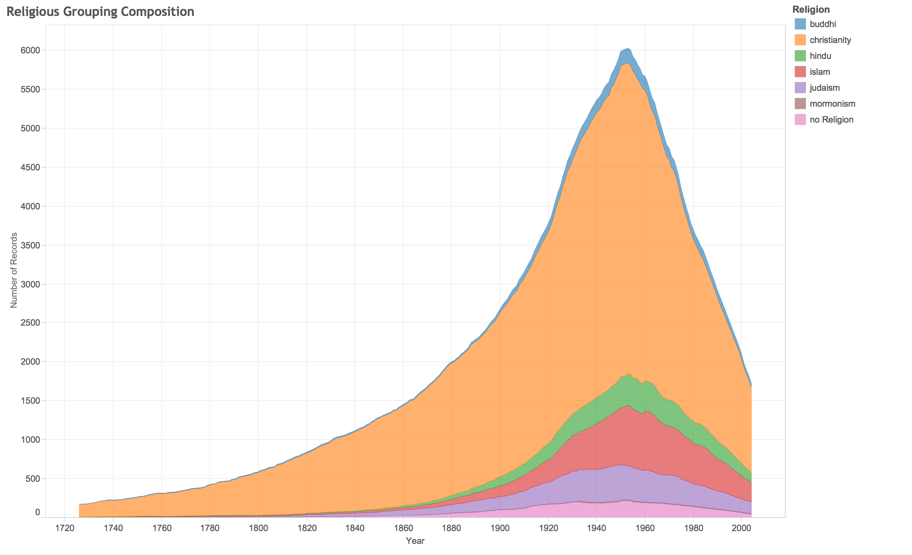

Slide 10
Areas For Improvement
Nothing in Russia.
Relatively low numbers in context.
Graph could be misleading.
We are not mapping general population trends just wiki articles.
Historically biased data.

